Slide 1

The Habits of
Highly Connected Learners
Stephen Downes
Integrating Technology 4 Active Lifelong Learning
October 20, 2013

Slide 2
Part A
The Semantic Condition
Where meaning comes from in networks

Slide 3
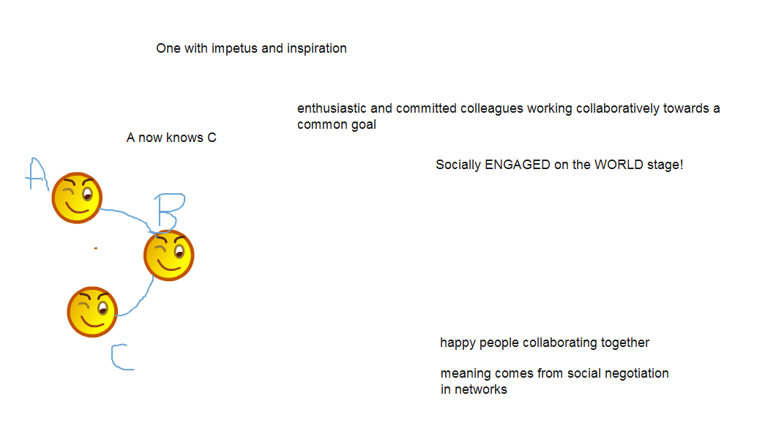
What is a Successful Network?

Slide 4
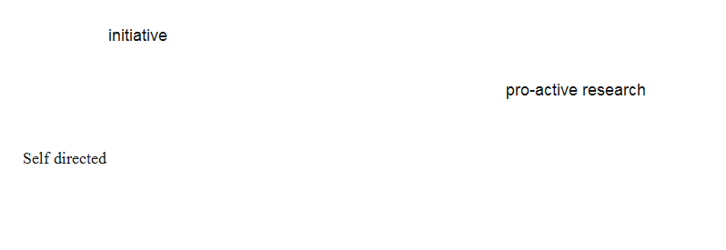
Autonomy

Slide 5
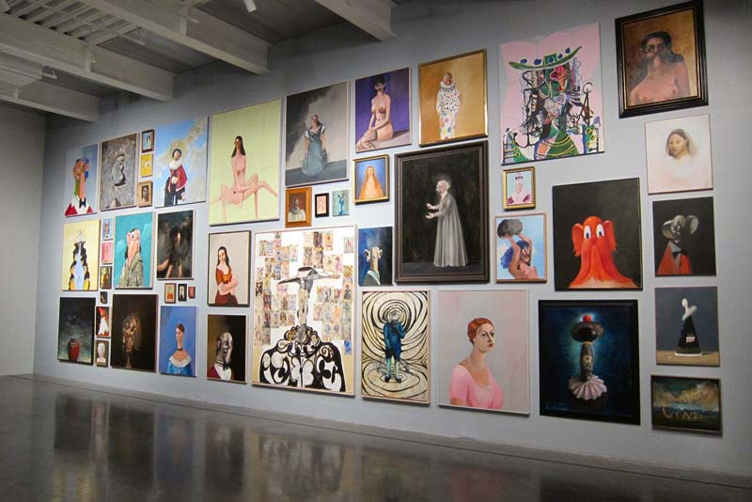
Freedom and the factors affecting mental states (empirical, cognitive, psychological)
http://halfanhour.blogspot.com/2010/11/model-of-autonomy.html

Slide 6

Freedom as the capacity to act on mental states (physical, social, structural, resources)

Slide 7

Scope and range of autonomous behaviour (expression, association, selection, method)

Slide 8
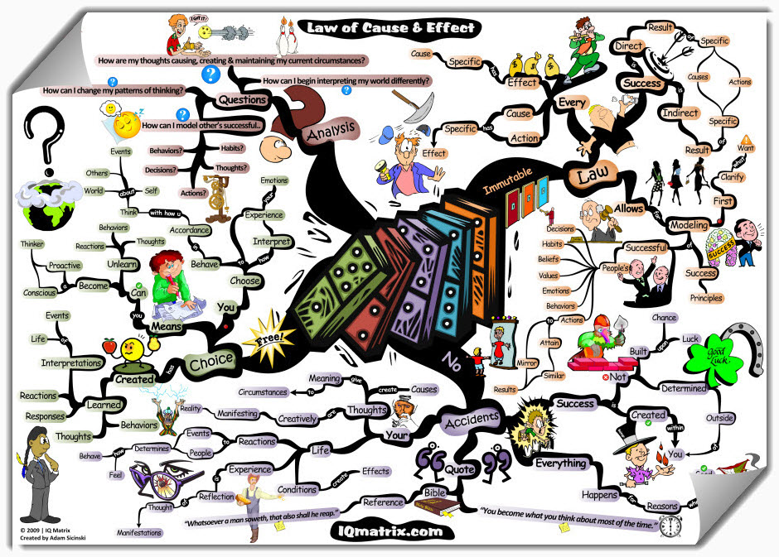
Effects of autonomous behaviour (impact, improvement)
http://blog.iqmatrix.com/law-of-cause-effect

Slide 9
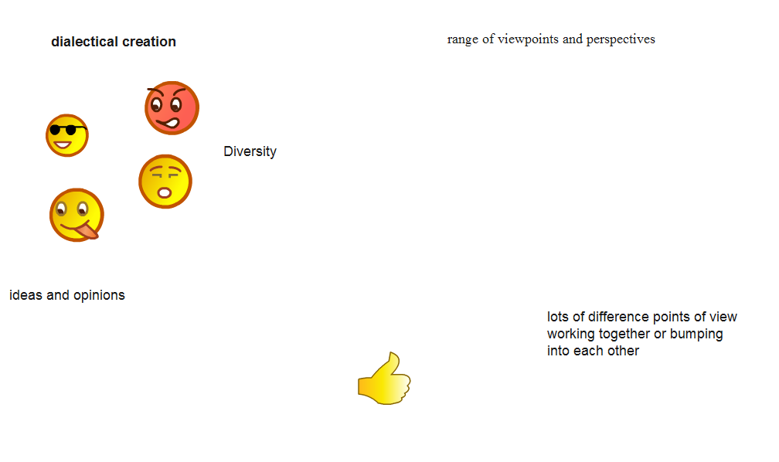
Diversity

Slide 10
Composition - many types of entities
http://lemire.me/fr/abstracts/DIVERSITY2008.html
http://www.huffingtonpost.com/stephen-downes/democratizing-education_b_794925.html

Slide 11
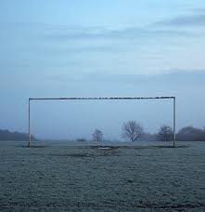
Intention (of goals, desires (cf JS Mill))

Slide 12
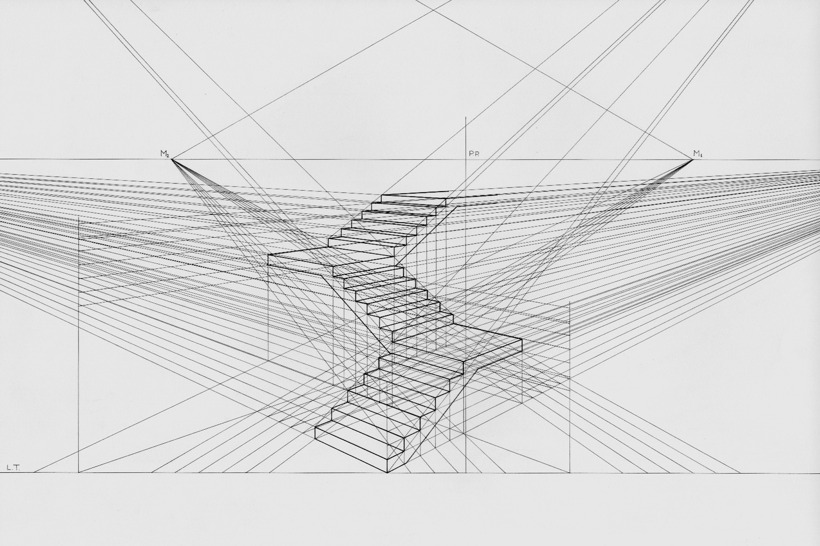
Perspective (uniqueness of point of view, language)

Slide 13
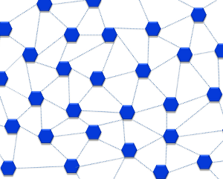
Mathematics of diversity (multiple inputs produce mesh networks)
http://lemire.me/fr/documents/publications/DiversityTechReport_October2008.pdf

Slide 14
Putnam, Florida, and the rest of it
Homophily and associationism
http://www.downes.ca/post/53544
http://profesorbaker.wordpress.com/2011/01/30/homophily-and-heterophily-what-fires-together-wires-together-cck11/

Slide 15
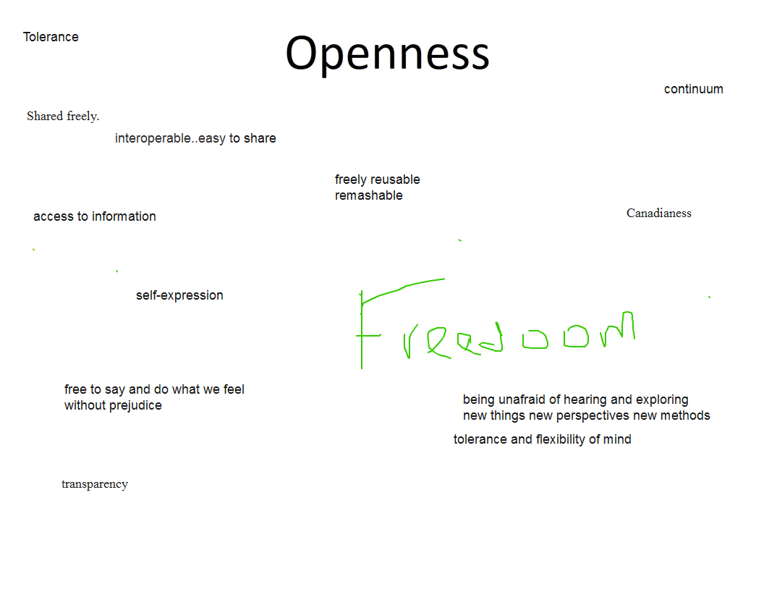
Openness

Slide 16
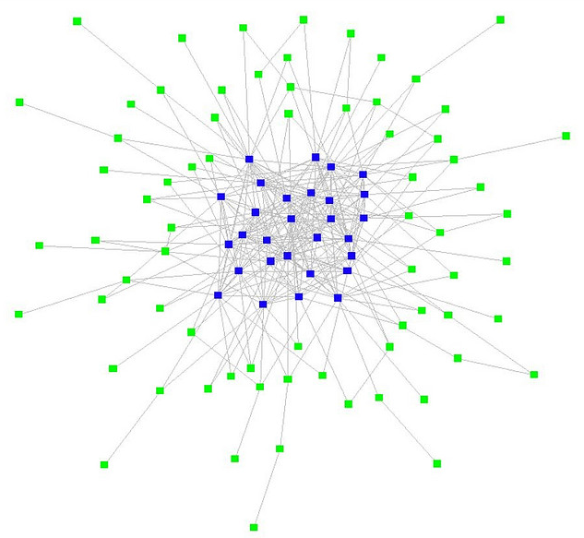
Open education
  Open content, teaching, assessment
  Stages of openness and terminal path
http://www.downes.ca/presentation/271
http://www.flickr.com/photos/ross/2916958593/

Slide 17
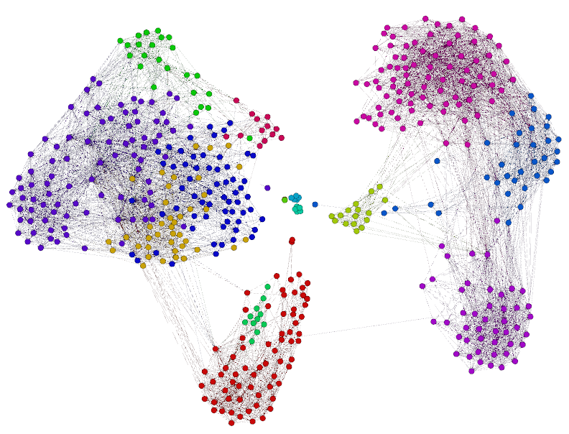
Open networks (clustering instead of grouping)

Slide 18
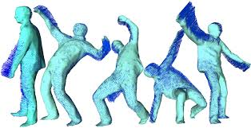
Flow (input, output, feedback, plasticity)

Slide 19
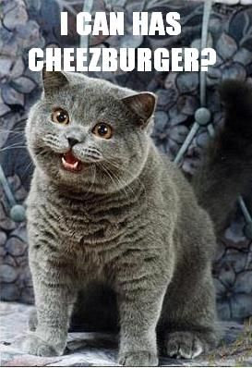
Open Educational Resources as the medium of communication

Slide 20
Interactivity

Slide 21

Influence vs emergence (thought-bubbles – “we perceive wholes where there are only holes”)
http://www.downes.ca/post/55001
http://connect.downes.ca/post/44222

Slide 22
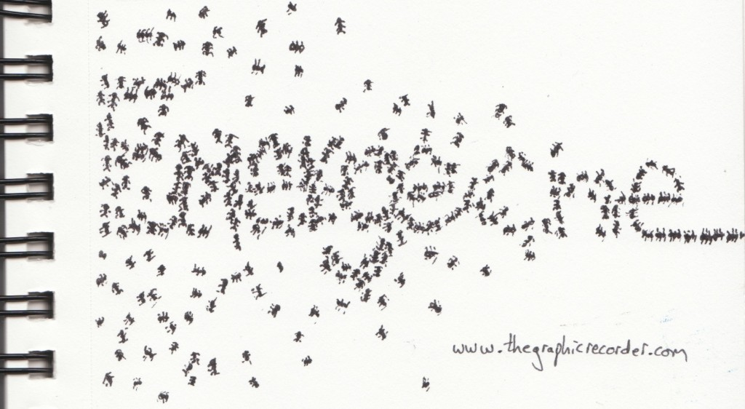
Types of Emergence (‘Scope’ vs ‘Level’)
http://www.thegraphicrecorder.com/2012/01/09/word-sketch-emergence/
http://www.downes.ca/post/42066

Slide 23
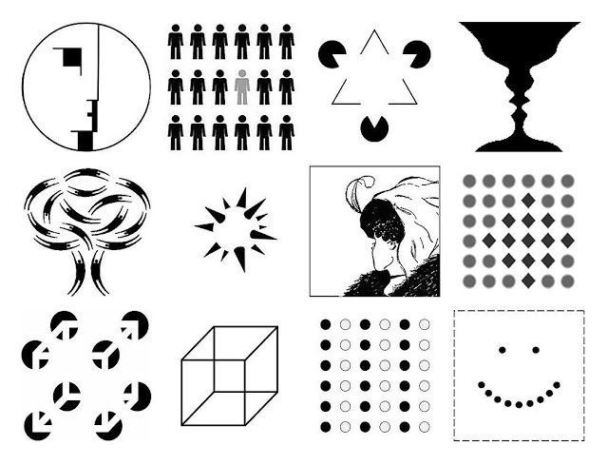
Ontology of emergence
  Ontological (real) vs perceptual (recognized)

Slide 24
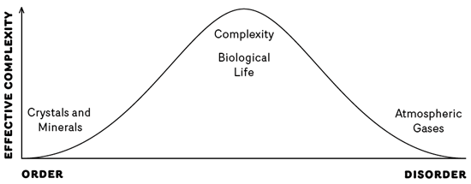
Connection to complexity & chaos

Slide 25
Part B
Highly Connected People
Living meaningfully in the networked world

Slide 26
Being Reactive

Slide 27
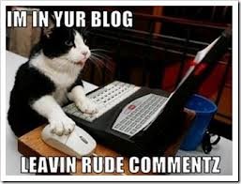
Publishing your own stuff is secondary to reading and commenting on other people's stuff

Slide 28

The first thing any connected person should be is receptive. Open.

Slide 29

Your content should be reactions to other people's points of view. This will ensure, first of all, that they read your comment, and second, that your post is relevant to the discussion at hand.
http://sanja.deviantart.com/

Slide 30
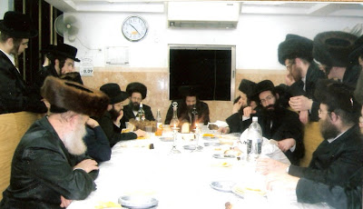
Posting, after all, isn't about airing your own views. It's about connecting (draw the link between their content and yours)

Slide 31
Going With the Flow

Slide 32
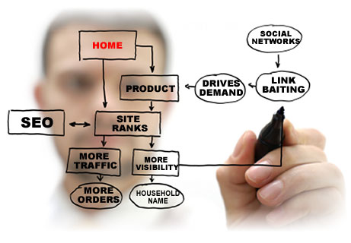
We all know those people in our online community who are out to "prove something," to "get things done," or to "market themselves."

Slide 33

These are people we tend to avoid. Because no matter what the topic of discussion, they'll weigh in with their pet project, peeve, or talking point.

Slide 34

It is more important to find the places to which you can add value rather than pursue a particular goal or objective.

Slide 35

This doesn't mean you shouldn't have any goals or principles for yourself. You should.
  that's what will inform your participation
  But your goals are not the same as other people's goals, and you need to respect that

Slide 36
Connection Comes First

Slide 37
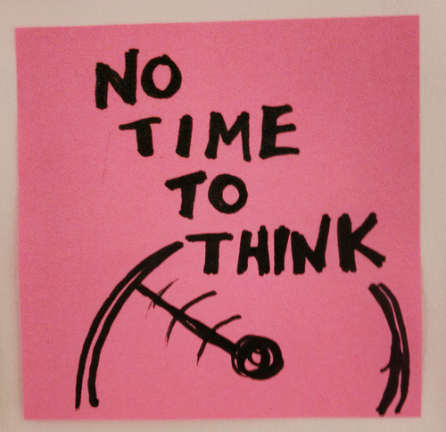
People talk about not having time for email, of not having time for blogs…

Slide 38
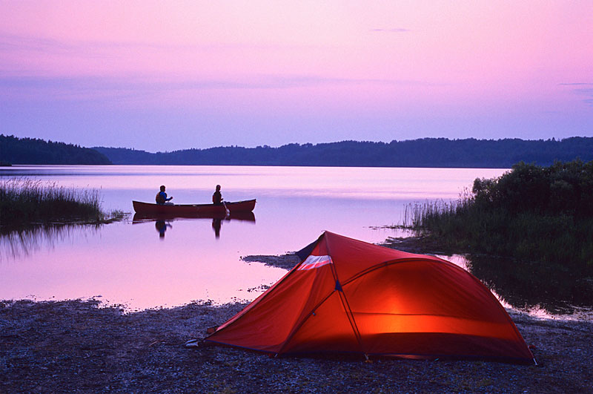
It's good to take a break and go out camping, or to the club, or whatever. But the idea of replacing your online connecting with busy-work is mistaken.

Slide 39

In almost all fields, connecting with others is the work.

Slide 40
If you don't have enough time for reading email, writing blog posts, or posting to discussion lists, ask yourself what other activities you are doing that are cutting in to your time. These are the things that are often less efficient uses of your time.

Slide 41
Connecting online, versus…
  spending time in meetings
  spending time traveling or commuting to work
  spending time reading books and magazines
  spending time telephoning people (or worse, on hold, or playing phone tag)

Slide 42
Sharing

Slide 43

We've all heard the advice to "think win-win." Forget that advice.
If you follow that advice, you will always be looking at things and saying, "What's in it for me?" That's exactly the wrong attitude to have in a connected world.

Slide 44
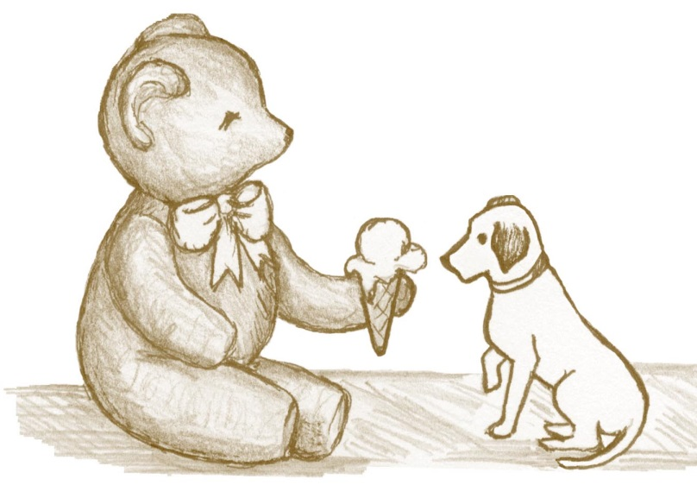
Share without thinking about what you will get in return.
Share without worrying about so-called "free-riders" or people taking advantage of your work.

Slide 45

You want to be needed and wanted.

Slide 46

When you share, people are more willing to share with you.

Slide 47
Learning for Ourselves

Slide 48
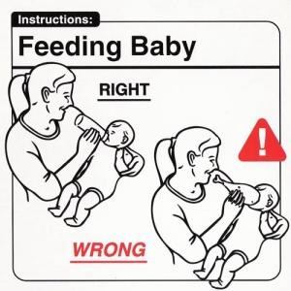
RTFM stands for "Read The Fine Manual" (or some variant thereof)

Slide 49

People should make the effort to learn for themselves before seeking instruction from others.

Slide 50
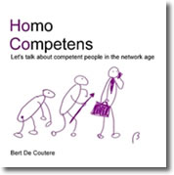
Taking the time and effort to look at this work is not merely respectful, it demonstrates competence and self-reliance.

Slide 51
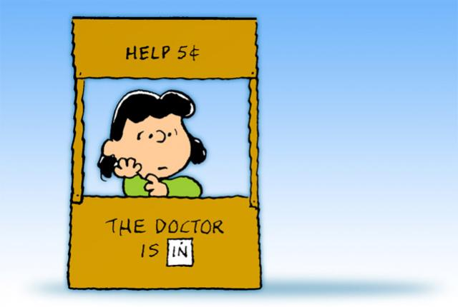
This saves people from giving you advice you don't need, and helps them focus on what's unique about your problem.

Slide 52
Cooperation

Slide 53

Offline people collaborate. They join teams, share goals, and work together.

Slide 54
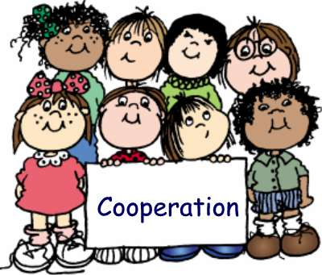
Online, people cooperate. They network. Each has his or her own goals and objectives.

Slide 55

Online communications are much more voluntary than offline communications. And successful online connectors recognize this.

Slide 56
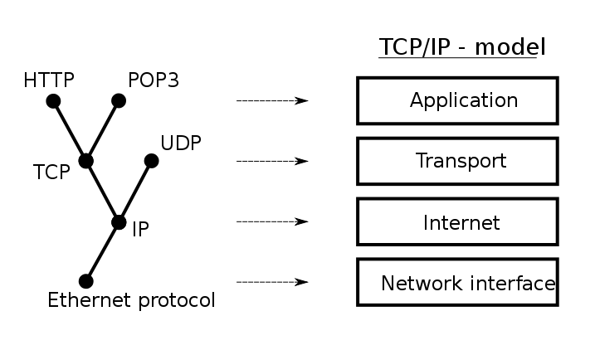
Cooperation is based on protocols.
  These are not rules-anybody can break them.
  They establish the basis for communication.

Slide 57
Engage

Slide 58

Having a cat can be as important for a physicist as having an advanced research lab.

Slide 59

Communication depends as much on feeling as it does with cognition.

Slide 60

People who use online communications "only for business are employing only a small part of the communications capacity of the Internet.

Slide 61

Learning and communicating are not merely acts of sending content over a wire. They are about engaging in (what Wittgenstein called) a "way of life.“

Slide 62
These common everyday things form the mental structure on which we hang the highly theoretical structure.

Slide 63
Stephen Downes
http://www.downes.ca

